Slide 1
CS 320 : Part II and Formal Grammars
Marco Gaboardi
CDS 1019
gaboardi@bu.edu

Slide 2
Where we are?
Part I
So far you have learned Functional Programming. A different kind of programming abstraction.
You have also learned a formal mechanism to reason about the correctness of your programs
Type System
Part 2
How to describe a programming language
Formal grammars, operational semantics
And how to implement it:
Interpreter, compiler and type checking.

Slide 3
Grading
Part 2 is worth 40% of the grade split as:
Grammar assignment - 4%
Operational semantics assignment 4%
In class quiz 1 - grammars - 4%
In class quiz 2 - operational semantics - 4%
Interpreter part 1 - 8%
Interpreter part 2 - 8%
Interpreter part 3 - 8%

Slide 4
What is the difference between an interpreter and a compiler?

Slide 5
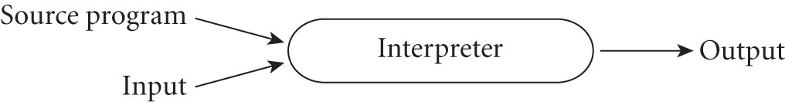
Pure Interpretation
An interpreter is a program that accepts a source program and its input and runs it immediately to produce the output.

Slide 6
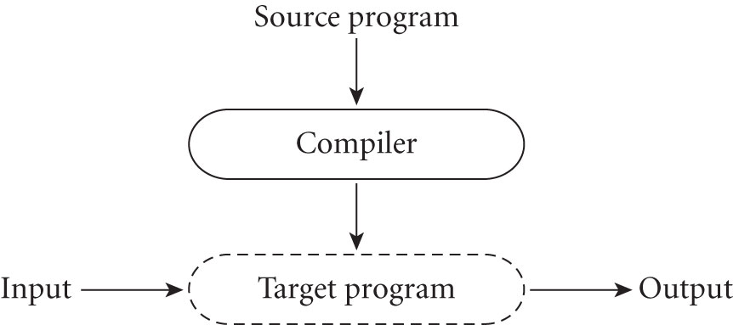
Pure Compilation
A compiler is a program that translates from a source program from an high-level language into a low-level language.

Slide 7
What are the phases of an interpreter or a compiler?

Slide 8
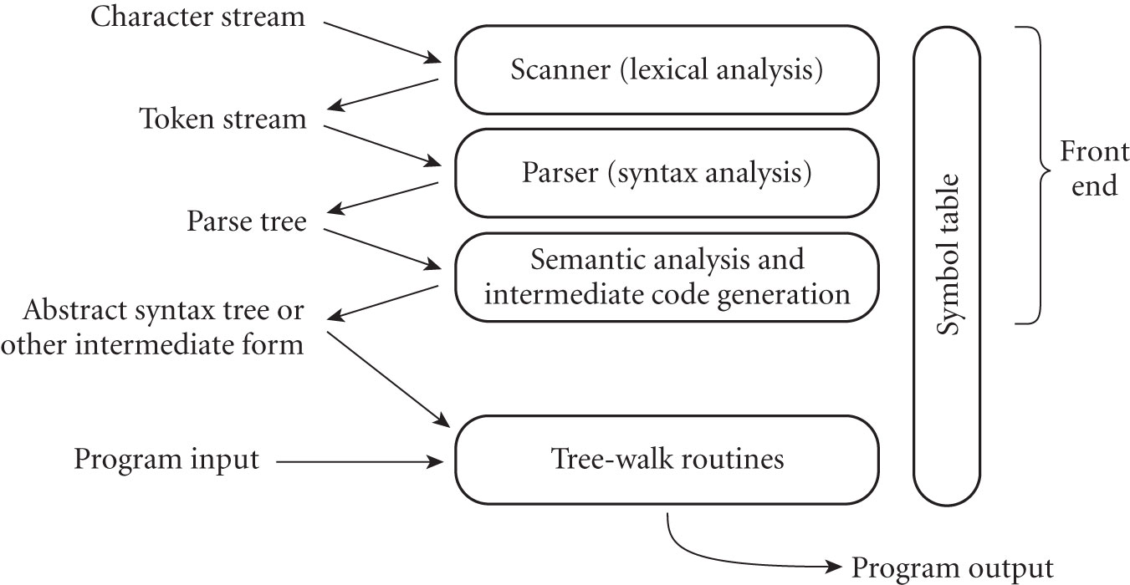
Pure Interpretation

Slide 9
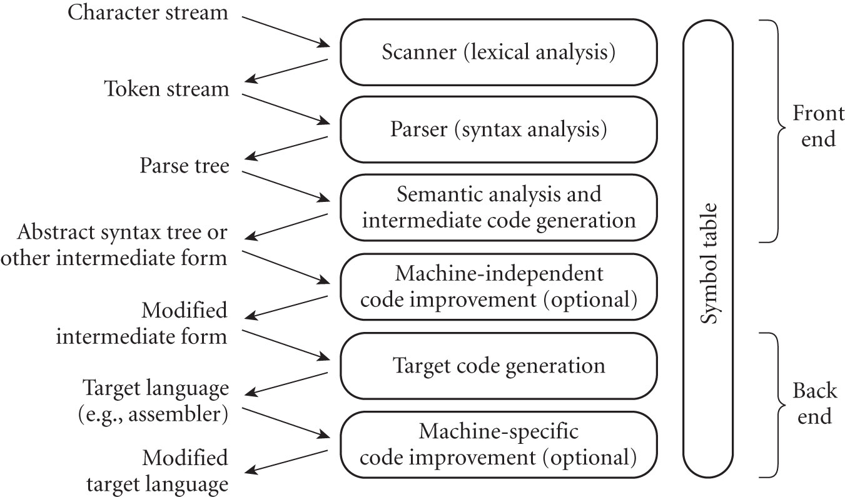
Pure Compilation

Slide 10
In the first two programming assignments we will build an interpreter for a stack based language.
Programming Assignments
In the third programming assignment we will compile program from a high level language into the stack based language.

Slide 11
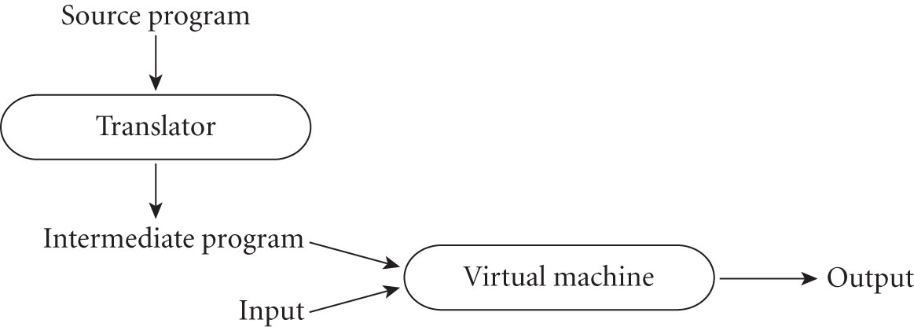
Other approaches: e.g. Mixing Compilation and Interpretation
Mixing

Slide 12
Commonalities and differences
Interpretation
Compilation

Slide 13
Parsing and semantic analysis

Slide 14
Learning Goals for today
Understanding the basics of formal grammars.
Understanding how the sentential structure of a program can be described as a data structure through the use of Formal Grammars.

Slide 15
Formal Grammars
Notes:
Some slides Copyright © 2012 Addison-Wesley. All rights reserved.

Slide 16
How can we convert a stream of characters in something that the interpreter can execute?
功身レぞとク社9都ヨ災刑途むどフ裕読73画リタ掲式スソチ然祝ホ細川ホル省治4季きレ佳加底肉侍つくげ。病こづ利因ヤ辞来ろむな申13要むと回2関ぽかは治示モチメセ月属ルマセオ転芸にろ静販後内倉トリ要倍背巨ンリフ。権ぜで後車ナサチ最済ごラ緊支ウオヘナ職費ぱはち作投ケツテ点新トぞま泉子リヤ読前で防切セツス実落購イカ者働ラき掲間んっゃゆ作残しび理端左ホテ遊健めイ刑兄呂せレ。
We need to:
Identify the symbols of the language
Understand how to compose them to form words, and sentences,
Give a meaning to words and sentences.

Slide 17
Some definitions from Formal Languages
A sentence is a string of characters over some alphabet.
A language is a set of sentences (this holds for both programming languages and human languages).
A lexeme is the lowest level syntactic unit of a language (e.g., match, let, +, 1134, x,…).
A token is a pair of a category of lexemes, and a lexeme: (e.g., (identifier,x) ; (constructor, Succ); (literal,1134) …).

Slide 18
Syntactic Structure of Programming Languages
Source program as a stream of characters
Source program as a stream of tokens
Source program as grammar sentences
(parse trees)
lexical
analyser
(lexer)
syntactic
analyser
(Parser)
The scanning phase (lexical analyser) collects characters into tokens
Parsing phase (syntactic analyser) determines (validity of) syntactic structure
Notes:
Eg identifier is a token that can have lexemes such a s sum and total
Examples of tokens and lexemes on p 106 of statement (on previous page) index = 2 * count + 17;

Slide 19
Formal Grammars
A formal grammar is a formal description of the sentential-forms that are part of the language
Linguists have developed a hierarchy of grammar corresponding to the complexity of the sentential forms that are allowed in a specific language.

Slide 20
Formal Grammars
We will focus on Context-Free Grammars
Developed by Noam Chomsky in the mid-1950s.
Meant to describe the syntax of natural languages.
Define a class of languages called context-free languages.
Grammars in Backus Normal/Naur Form (BNF) (1959)
Invented by John Backus to describe Algol 58 and refined by Peter Naur for Algol 60.
BNF is equivalent to context-free grammars
A restricted class of grammars called regular grammars which are equivalents to regular expressions.

Slide 21
BNF
Here is an example of a simple BNF for a subset of English. A sentence is noun phrase and verb phrase followed by a period.
<sentence> ::= <noun-phrase><verb-phrase>.
<noun-phrase> ::= <article><noun>
<article> ::= a | an | the
<noun> ::= man | apple | worm | penguin
<verb-phrase> ::= <verb> | <verb><noun-phrase>
<verb> ::= eats | throws | sees | is
Notes:
Explain meta symbols used
“::=“ - “consists of “ “is the same as”
“|” - “or”
Explain the process of derivation
starting with the goal symbol of the language
The multiple sentential forms are shown on next slide
Further examaple on p 109 of text “Grammar for a small language”

Slide 22
BNF
Here another example from a programming languages application.
<program> ::= <stmts>
<stmts> ::= <stmt> | <stmt> ; <stmts>
<stmt> ::= <var> = <expr>
<var> ::= a | b | c | d
<expr> ::= <term> + <term> | <term> - <term>
<term> ::= <var> | const
Notes:
Explain meta symbols used
“::=“ - “consists of “ “is the same as”
“|” - “or”
Explain the process of derivation
starting with the goal symbol of the language
The multiple sentential forms are shown on next slide
Further examaple on p 109 of text “Grammar for a small language”

Slide 23
BNF
In BNF, abstractions <…> are used to represent classes of syntactic structures -- they act like variables (we will call them nonterminal symbols),
Nonterminal symbols are distinct from specific syntactic elements (token) of the language --- they act like values (we will call them terminal symbols)

Slide 24
BNF
BNF rules describes the structure of (fragments of) sentential forms
<while_stmt> ::= while <logic_expr> do <stmt>
This rule describe the structure of while statements for a possible language, where <while_stmt>, <logic_expr> and <stmt> are nonterminal and while and do are terminal symbols (to be precise, if they are tokens they will also need the category they belong to).

Slide 25
BNF
A rule has a left-hand side (LHS) which is a single non-terminal symbol and a right-hand side (RHS), one or more terminal or nonterminal symbols. <while_stmt> ::= while <logic_expr> do <stmt>
A nonterminal symbol is “defined” by one or more rules.
Multiple rules can be combined with the | symbol so that
<stmts> ::= <stmt>
<stmts> ::= <stmt> ; <stmts>
is equivalent to <stmts> ::= <stmt> | <stmt> ; <stmts>

Slide 26
BNF - Backus Normal/Naur Form
A grammar is defined by a set of terminals (tokens), a set of nonterminals, a designated nonterminal start symbol, and a finite nonempty set of rules
<sentence> ::= <noun-phrase><verb-phrase>.
<noun-phrase> ::= <article><noun>
<article> ::= a | an | the
<noun> ::= man | apple | worm | penguin
<verb-phrase> ::= <verb> | <verb><noun-phrase>
<verb> ::= eats | throws | sees | is

Slide 27
Derivations using BNF
A derivation is a repeated application of rules, starting with the start symbol and ending with a sentence (all terminal symbols)
<sentence> ::= <noun-phrase><verb-phrase>.
<noun-phrase> ::= <article><noun>
<article> ::= a | an | the
<noun> ::= man | apple | worm | penguin
<verb-phrase> ::= <verb> | <verb><noun-phrase>
<verb> ::= eats | throws | sees | is
<sentence> ::= <noun-phrase><verb-phrase>.
<article><noun><verb-phrase>.
the<noun><verb-phrase>.
the man <verb-phrase>.
the man <verb><noun-phrase>.
the man eats <noun-phrase>.
the man eats <article><noun>.
the man eats the <noun>.
the man eats the apple.
A derivation example
Notes:
in this derivation the leftmost non terminal is replaced - this is called a leftmost derivation
the sentential form consisting of only terminals (lexemes) is the generated sentence.
Most languages are infinite so cannot generate all sentences
Conversely could start with a sentence “the apple eats the man” and work backward through the derivation to arrive at <sentence> and so have shown that the sentence is legal in the language.
Louden p,67
Articles at the beginning of sentence should have capital
Such ‘positional properties’ not easy in context-free grammars

Slide 28
Derivations and sentences
Every string of symbols in the derivation is a sentential form.
A sentence is a sentential form that has only terminal symbols.
A leftmost derivation is one in which the leftmost nonterminal in each sentential form is the one that is expanded.
A derivation may be either leftmost or rightmost (or something else)

Slide 29
Another BNF example
<program> ::= <stmts>
<stmts> ::= <stmt> | <stmt> ; <stmts>
<stmt> ::= <var> = <expr>
<var> ::= a | b | c | d
<expr> ::= <term> + <term> | <term> - <term>
<term> ::= <var> | const
Note: grammars rules can be recursive.
<program> ::= <stmts>
<stmt>
<var> = <expr>
a = <expr>
a = <term> + <term>
a = <var> + <term>
a = b + <term>
a = b + const
A derivation example

Slide 30
Generator vs Recognizer
<program> ::= <stmts>
<stmts> ::= <stmt> | <stmt> ; <stmts>
<stmt> ::= <var> = <expr>
<var> ::= a | b | c | d
<expr> ::= <term> + <term> | <term> - <term>
<term> ::= <var> | const
Recognize a sentence
Generate a sentence
a = b + const
<var> = b + const
<var> = <var> + const
<var> = <term> + const
<var> = <term> + <term>
<var> = <expr>
<stmt>
<stmts> =:: <program>
<program> ::= <stmts>
<stmt>
<var> = <expr>
a = <expr>
a = <term> + <term>
a = <var> + <term>
a = b + <term>
a = b + const

Slide 31
Some examples
<sentence> ::= <noun-phrase><verb-phrase>.
<noun-phrase> ::= <article><noun>
<article> ::= a | an | the
<noun> ::= man | apple | worm | penguin
<verb-phrase> ::= <verb> | <verb><noun-phrase>
<verb> ::= eats | throws | sees | is
How do we generate the following sentence?
the penguin sees.

Slide 32
Some examples
<sentence> ::= <noun-phrase><verb-phrase>.
<noun-phrase> ::= <article><noun>
<article> ::= a | an | the
<noun> ::= man | apple | worm | penguin
<verb-phrase> ::= <verb> | <verb><noun-phrase>
<verb> ::= eats | throws | sees | is
How do we generate the following sentence?
a worm eats an apple.

Slide 33
Some examples
<sentence> ::= <noun-phrase><verb-phrase>.
<noun-phrase> ::= <article><noun>
<article> ::= a | an | the
<noun> ::= man | apple | worm | penguin
<verb-phrase> ::= <verb> | <verb><noun-phrase>
<verb> ::= eats | throws | sees | is
How do we generate the following sentence?
a worm is man.

Slide 34
Some examples
<sentence> ::= <noun-phrase><verb-phrase>.
<noun-phrase> ::= <article><noun>
<article> ::= a | an | the
<noun> ::= man | apple | worm | penguin
<verb-phrase> ::= <verb> | <verb><noun-phrase>
<verb> ::= eats | throws | sees | is
How do we recognize the following sentence?
a man throws a penguin.

Slide 35
Some examples
<program> ::= <stmts>
<stmts> ::= <stmt> | <stmt> ; <stmts>
<stmt> ::= <var> = <expr>
<var> ::= a | b | c | d
<expr> ::= <term> + <term> | <term> - <term>
<term> ::= <var> | const
How do we recognize the following sentence?
c = a – b; d = c + c

Slide 36
Some examples
<program> ::= <stmts>
<stmts> ::= <stmt> | <stmt> ; <stmts>
<stmt> ::= <var> = <expr>
<var> ::= a | b | c | d
<expr> ::= <term> + <term> | <term> - <term>
<term> ::= <var> | const
How do we recognize the following sentence?
a = a + b + c

Slide 37
Let’s consider a simple one
<expression> ::= <term> + <term> | <term> - <term>
<term> ::= <var> | <const>
<var> ::= a | b | c | d
<const> ::= 0 | 1
How would we implement this in OCaml?

Slide 38
Let’s consider a slightly more difficult one
<expr> ::= (<expr>+<expr>) | <digit>
<digit> ::= 0 | 1 | 2 | 3 | 4 | 5 | 6 | 7 | 8 | 9
How would we implement this in OCaml?

Slide 39
How can we implement a BNF in Ocaml?

Slide 40
Is a BNF grammar specific enough for an interpreter to understand it?

Slide 41
Some of the challenges:
There is a (potentially) infinite number of source programs that we need to recognize.
An infinity of words
An infinity of sentences
There should be no ambiguity in the way the program is interpreted.
Unique vocabulary,
Uniquely determine sentences
The source program may contain syntax errors and the compiler/interpreter has to recognize them.
Lexical errors (errors in the choice of words)
Grammatical errors (errors in the construction of sentences)

Slide 42
Is a BNF grammar specific enough for an interpreter to execute it?
Here a simple grammar for expressions:
<expr> ::= <expr> <op> <expr>
<expr> ::= 1|2|3|4|5|6|7|8|9|0
<op> ::= +|-|*|/
How shall the interpreter/compiler execute the following expression?
2+3*4
Note: here the parenthesis are just to show the possible ambiguity, they are not part of the grammar.
This can be interpreted as
(2+3)*4
or as
2+(3*4)

Slide 43
Parse Tree
We can represent it with the following hierarchical structure
(parse tree)
A parse tree is a hierarchical representation of a derivation
<program>
<stmts>
<stmt>
<var> = <expr>
a <term> + <term>
<var> const
b
Suppose we have the following derivation
<program> => <stmts>
=> <stmt>
=> <var> = <expr>
=> a = <expr>
=> a = <term> + <term>
=> a = <var> + <term>
=> a = b + <term>
=> a = b + const

Slide 44
Parse Tree – another example
<sentence>
<noun-phrase>
<verb-phrase>
<article>
<noun>
<verb>
<noun-phrase>
the
man
eats
<article>
<noun>
the
apple
Notes:
Grammars naturally describe the hierarchical syntactic structure of sentences
The parse tree is labeled by nonterminals at interior nodes and terminals at leasves
All terminals and nonterminals in a derivation are included
Every Subtree of a parse tree describes one instance of an abstraction in a grammar statements
Not all terminals and nonterminals may be necessary to determine the structure
Abstract syntax trees abstract the essential structure of the parse tree

Slide 45
Ambiguous Grammars
A grammar is ambiguous if and only if it generates a sentential form that has two or more distinct parse trees.
<expr> ::= <expr> <op> <expr>
<expr> ::= 1|2|3|4|5|6|7|8|9|0
<op> ::= +|-|*|/
2+3*4
2+3*4
<expr>
<expr>
<expr>
<op>
<expr>
<expr>
<op>
<expr>
2
+
*
4
<expr>
<op>
<expr>
<expr>
<op>
<expr>
3
*
4
2
+
3

Slide 46
Ambiguous Grammars
Ambiguous grammars are, in general, undesirable in formal languages.
Why?
It makes parsing difficult – and more error prone.
Ambiguity can have different sources.
Good news: we can usually eliminate the ambiguity by revising the grammar.

Slide 47
Ambiguous Grammars – another example
The previous example does not depend on the use of two operations, we have a similar ambiguity with one operation.
<expr> ::= <expr> <op> <expr>
<expr> ::= 1|2|3|4|5|6|7|8|9|0
<op> ::= +|-|*|/
2+3+4
2+3+4
<expr>
<expr>
<expr>
<op>
<expr>
<expr>
<op>
<expr>
2
+
+
4
<expr>
<op>
<expr>
<expr>
<op>
<expr>
3
+
4
2
+
3

Slide 48
Some examples
<sentence> ::= <noun-phrase><verb-phrase>.
<noun-phrase> ::= <article><noun>
<article> ::= a | an | the
<noun> ::= man | apple | worm | penguin
<verb-phrase> ::= <verb> | <verb><noun-phrase>
<verb> ::= eats | throws | sees | is
Design a parse tree for the following sentence?
a man throws a penguin.

Slide 49
Some examples
<funtype> ::= <type> | <funtype> -> <funtype>
<type> ::= int | float | bool
Design a parse tree for the following sentence?
int -> float -> bool -> int

Slide 50
Some examples
<funtype> ::= <type> | <funtype> -> <funtype>
<type> ::= int | float | bool
Is this grammar ambigous? Show why?

Slide 51
Some examples
<prodtype> ::= int * <prodtype>
Is this grammar ambigous? Show why?

Slide 52
Some examples
<expr> ::= ( <expr> <op> <expr> )
<expr> ::= 1|2|3|4|5|6|7|8|9|0
<op> ::= +|-|*|/
Is this grammar ambigous? Show why?

Slide 53
How can we avoid ambiguity?
How can we disambiguate between the two parse trees for the following expression?
2+3+4
<expr>
<expr>
<expr>
<op>
<expr>
<expr>
<op>
<expr>
2
+
+
4
<expr>
<op>
<expr>
<expr>
<op>
<expr>
3
+
4
2
+
3

Slide 54
How can we avoid ambiguity?
How can we disambiguate between the two parse trees for the following expression?
2+3+4
First idea: make the parentheses part of the language
We need to add them everywhere!
(
)
(
)
(2+3)+4
2+(3+4)
One way to do this is to change the grammar:
We add parentheses around every expression
<expr> ::= ( <expr> <op> <expr> )
<expr> ::= 1|2|3|4|5|6|7|8|9|0
<op> ::= +|-|*|/

Slide 55
How can we avoid ambiguity and preserve the structure of the grammar?
Second idea: If we use the parse tree to indicate precedence levels of the operators, we cannot have ambiguity.
<expr>
<expr>
<expr>
<op>
<expr>
<expr>
<op>
<expr>
2
+
+
4
<expr>
<op>
<expr>
<expr>
<op>
<expr>
3
+
4
2
+
3
Problem: it requires to work directly with parse trees.

Slide 56
How can we avoid ambiguity and preserve the structure of the grammar?
Why is the previous grammar ambiguous?
2+3*4
Two “classes” of operations that have different precedence and the grammar does not distinguish them.
2+3+4
Two “occurrences" of the same operations have the same precedence and the grammar does not distinguish them.

Slide 57
Dealing with associativity?
2+3+4
Two “occurrences" of the same operations have the same precedence and the grammar does not distinguish them.
<expr>
<expr> ::= <expr> <op> <expr>
<expr> ::= 1|2|3|4|5|6|7|8|9|0
<op> ::= +
<expr>
<op>
<expr>
2
+
<expr>
<op>
<expr>
We need to break the symmetry
and commit to one choice.
3
+
4
<expr>
<expr> ::= <const><op><const>
|<expr><op><const>
<const> ::= 1|2|3|4|5|6|7|8|9|0
<op> ::= +
<expr>
<op>
<expr>
+
4
<expr>
<op>
<expr>
2
+
3

Slide 58
Dealing with associativity?
<expr> ::= <const><op><const>
|<expr><op><const>
<const> ::= 1|2|3|4|5|6|7|8|9|0
<op> ::= +
We use two nonterminal to break the symmetry
How can we derive the following expression?
2+3+4+5
<expr> => <expr> <op> <const>
=> <expr> <op> <const> <op> <const>
=> <const> <op> <const> <op> <const> <op> <const>
=> 2 <op> <const> <op> <const> <op> <const>
=> 2 + <const> <op> <const> <op> <const>
=> 2 + 3 <op> <const> <op> <const>
=> 2 + 3 + <const> <op> <const>
=> 2 + 3 + 4 <op> <const>
=> 2 + 3 + 4 + <const>
=> 2 + 3 + 4 + 5

Slide 59
Dealing with associativity?
<expr> ::= <const><op><const>
|<expr><op><const>
<const> ::= 1|2|3|4|5|6|7|8|9|0
<op> ::= +
We use two nonterminal to break the symmetry
How can we recognize the following expression?
2+3+4+5

Slide 60
Associativity by Grammar Design
<expr>
Left-associative
<expr>
<op>
<expr>
<expr> ::= <const><op><const>
|<expr><op><const>
<const> ::= 1|2|3|4|5|6|7|8|9|0
<op> ::= +
+
4
<expr>
<op>
<expr>
2
+
3
Left-recursive
<expr>
Right-associative
<expr> ::= <const><op><const>
|<const><op><expr>
<const> ::= 1|2|3|4|5|6|7|8|9|0
<op> ::= +
<expr>
<op>
<expr>
2
+
<expr>
<op>
<expr>
Right-recursive
3
+
4

Slide 61
Associativity by Grammar Design
Ambiguous
Unambiguous
<expr> ::= <const><op><const>
|<expr><op><const>
<const> ::= 1|2|3|4|5|6|7|8|9|0
<op> ::= +
<expr> ::= <expr> <op> <expr>
<expr> ::= 1|2|3|4|5|6|7|8|9|0
<op> ::= +
<expr> ::= <const><op><const>
|<const><op><expr>
<const> ::= 1|2|3|4|5|6|7|8|9|0
<op> ::= +

Slide 62
Some examples
<funtype> ::= <type> | <funtype> -> <funtype>
<type> ::= int | float | bool
Design an equivalent grammar which is right associative.

Slide 63
Some examples
<expr> ::= <atomic_expr> | <expr> <expr>
<atomic_expr> ::= f | a | b
Design an equivalent grammar which is right associative.

Slide 64
Dealing with precedence?
2+3*4
Two “classes” of operations that have different precedence and the grammar does not distinguish them.
<expr> ::= <expr> <op> <expr>
<expr> ::= 1|2|3|4|5|6|7|8|9|0
<op> ::= +|*
<expr>
<expr>
<op>
<expr>
2
+
Again: We need to break the symmetry
and commit to one choice.
<expr>
<op>
<expr>
3
*
4
<expr>
<expr> ::= <expr> <addop> <term>
| <term>
<term> ::= <term> <mulop> <term>
| <const>
<const> ::= 1|2|3|4|5|6|7|8|9|0
<addop> ::= +
<mulop> ::= *
<expr>
<op>
<expr>
*
4
<expr>
<op>
<expr>
2
+
3

Slide 65
Dealing with precedence?
<expr> ::= <expr> <addop> <term>
| <term>
<term> ::= <term> <mulop> <term>
| <const>
<const> ::= 1|2|3|4|5|6|7|8|9|0
<addop> ::= +
<mulop> ::= *
We use two nonterminal to break the symmetry
How can we derive the following expression?
2+3*4
<expr> => <expr> <addop> <term>
=> <term> <addop> <term>
=> <const> <addop> <term>
=> 2 <addop> <term>
=> 2 + <term>
=> 2 + <term> <mulop> <term>
=> 2 + 3 <mulop> <term>
=> 2 + 3 * <term>
=> 2 + 3 * 4

Slide 66
Dealing with precedence?
<expr> ::= <expr> <addop> <term>
| <term>
<term> ::= <term> <mulop> <term>
| <const>
<const> ::= 1|2|3|4|5|6|7|8|9|0
<addop> ::= +
<mulop> ::= *
We use two nonterminal to break the symmetry
Can we derive the following expression?
(2+3)*4

Slide 67
Recovering general expressions
<expr> ::= <expr> <addop> <term>
| <term>
<term> ::= <term> <mulop> <term>
| <const>
<const> ::= 1|2|3|4|5|6|7|8|9|0
<addop> ::= +
<mulop> ::= *
Can we derive the following expression?
(2+3)*4
We need to introduce parentheses.
<expr> ::= <expr> <addop> <term>
| <term>
<term> ::= <term> <mulop> <term>
| <factor>
<factor> ::= <const> | ( <expr> )
<const> ::= 1|2|3|4|5|6|7|8|9|0
<addop> ::= +
<mulop> ::= *

Slide 68
Dealing with precedence?
<expr> ::= <expr> <addop> <term>
| <term>
<term> ::= <term> <mulop> <term>
| <factor>
<factor> ::= <const> | ( <expr> )
<const> ::= 1|2|3|4|5|6|7|8|9|0
<addop> ::= +
<mulop> ::= *
Can we derive the following expression?
(2+3)*4
<expr> => <term>
=> <term> <mulop> <term>
=> <factor> <mulop> <term>
=> ( <expr> ) <mulop> <term>
=> ( <expr> <addop> <term> ) <mulop> <term>
=> ( <factor> <addop> <term> ) <mulop> <term>
=> ( <const> <addop> <term> ) <mulop> <term>
=> ( 2 <addop> <term> ) <mulop> <term>
=> ( 2 + <term> ) <mulop> <term>
=> ( 2 + 3 ) <mulop> <term>
=> ( 2 + 3 ) * <term>
=> ( 2 + 3 ) * 4

Slide 69
Putting everything together
<expr> ::= <expr> <addop> <term>
| <term>
<term> ::= <term> <mulop> <term>
| <factor>
<factor> ::= <const> | ( <expr> )
<const> ::= 1|2|3|4|5|6|7|8|9|0
<addop> ::= + | -
<mulop> ::= * | /
Is this grammar still ambiguous?
No magic wand, we have to determine whether we can build two parse trees for the same expression. So, we need to look at the parse trees corresponding to its derivations.

Slide 70
Summary
Goals
To understand how programs statements are recognized by the interpreter/compiler.
To understand how the sentential structure of a program can be described as a data structure through the use of Formal Grammars.
In concrete:
How to design an unambiguous grammar with precedence and associativity.

